Slide 1

Ventilator Weaning Strategies in the ICU
Rena Laliberte BS, RRT
Clinical Education Specialist
Henry Ford Hospital - Detroit
Notes:
To do list
-Citations embedded
-Color palate decisions

Slide 2
c
Disclosures
Honorarium received by Respiratory Associates
No other disclosures.

Slide 3
D
Objectives
Review current data supporting use of non-invasive ventilation (NIV) post-extubation in high risk patients
Review clinical outcomes that are improved by NIV
Reviewing current data supporting use of high flow nasal cannula (HFNC) post-extubation in low to high risk patients
Review evidence for NIV + HFNC vs HFNC post-extubation
Summarize the current available data

Slide 4
c
Case 1
67 y/o male with COPD, CHF with EF 35%, HTN, HLD who is admitted to ICU and mechanically ventilated > 3 days for acute respiratory failure secondary to community acquired pneumonia.
Vitals: T 38.6 F; BP 140/84; HR 89; RR 22; SpO2 98% on FiO2 30% and PEEP 5

Slide 5
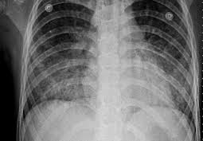
c
Case 1
Physical Exam
Intubated, sedated but easily arousable
CV: Regular rate and rhythm
Resp: Mild crackles at the bases, no rhonchi
Abd: Soft, good bowel sounds
Neuro: A&O X 3, strong cough and gag
Passed SBT
Notes:
To do list
-Citations embedded
-Color palate decisions

Slide 6
DDisc
Case 1
Which of the following is true regarding extubation strategy for this patient?
1. Post-extubation NIV will only reduce rate of reintubation
2. Post-extubation NIV does not have change any clinical outcomes
3. Post-extubation NIV will reduce rate of intubation and 60 d mortality
4. Post-extubation NIV is contraindicated in this patient

Slide 7
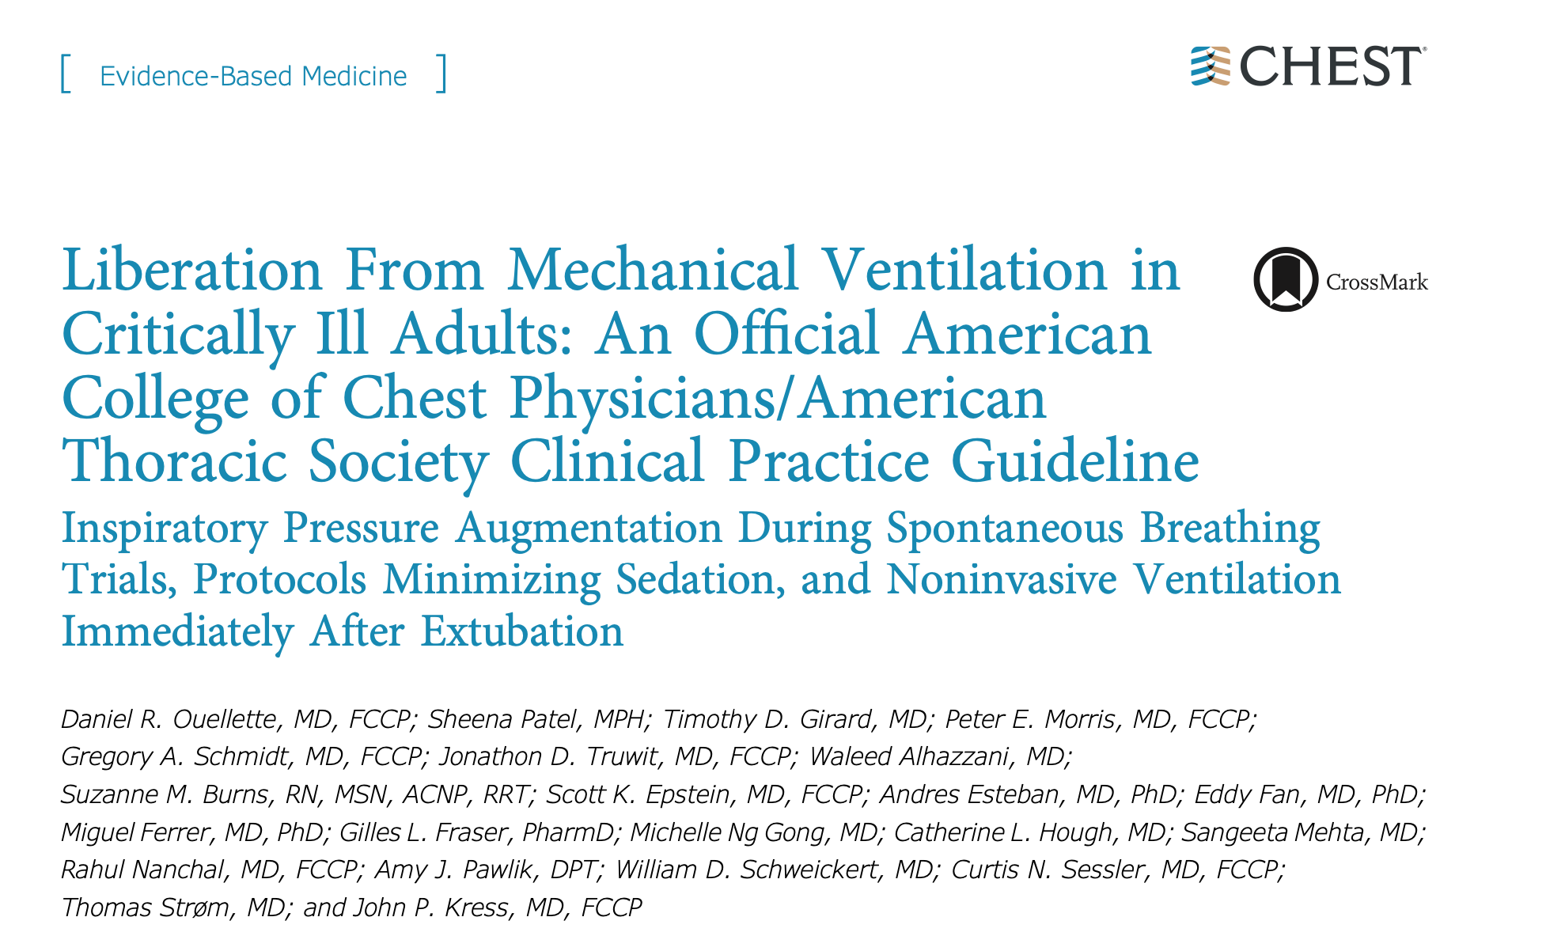
c
Evidence
Ouellette et al, Chest. 2017 Jan;151(1):166-180
Notes:
Neither guideline is intended to impose a standard of care. They provide the basis for rational decisions in the liberation of patients from mechanical ventilation.

Slide 8
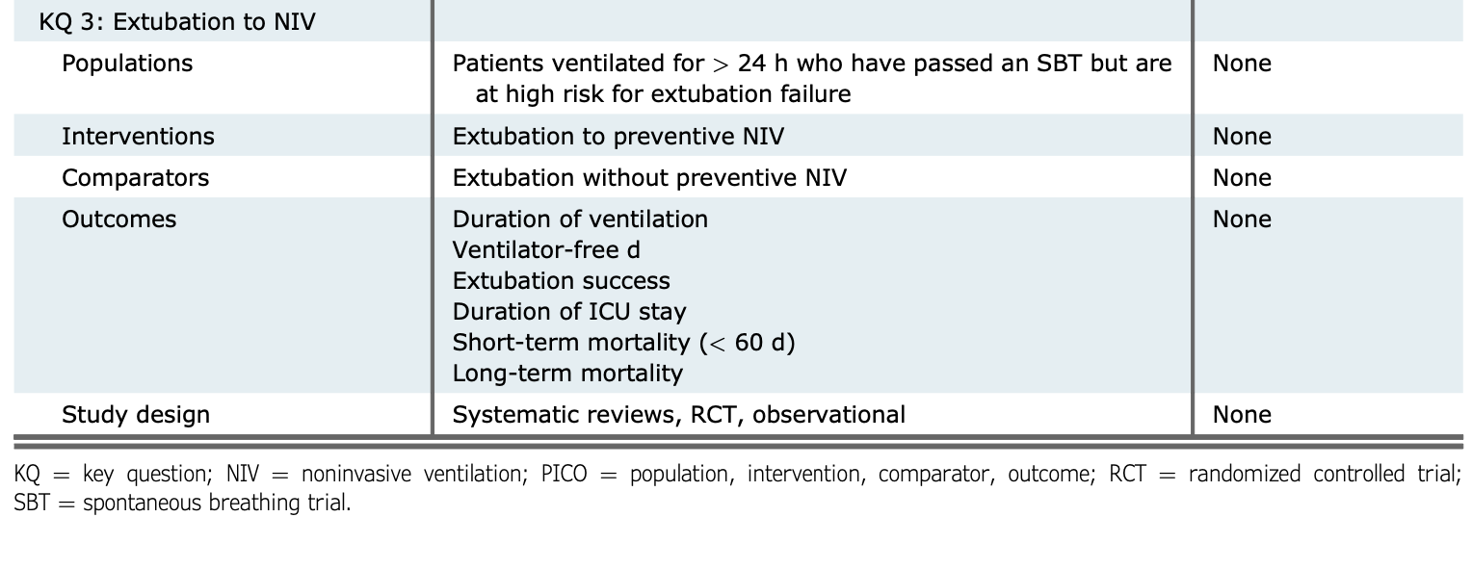
c
PICO
-
Ouellette et al, Chest. 2017 Jan;151(1):166-180
Notes:
To do list
-Citations embedded
-Color palate decisions

Slide 9
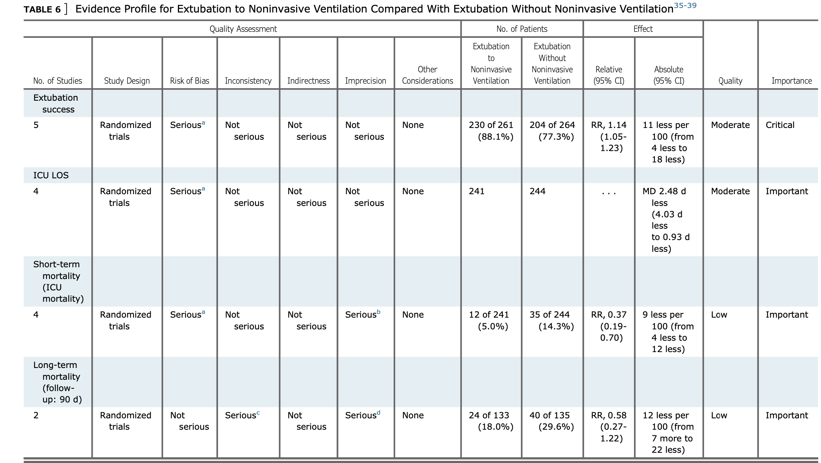
c
Evidence
-
Ouellette et al, Chest. 2017 Jan;151(1):166-180
Notes:
To do list
-Citations embedded
-Color palate decisions

Slide 10
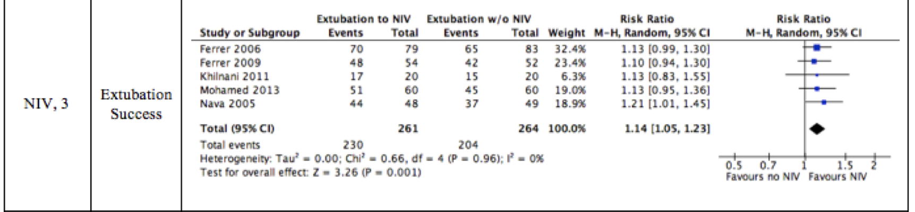
c
Evidence
NIV improves extubation success
Ouellette et al, Chest. 2017 Jan;151(1):166-180
Notes:
Nava et al35 randomized 97 high- risk patients who were extubated following successful SBT to receive either NIV or standard care 1 h after extubation. High-risk patients were those who failed more than one SBT, had a PaCO2 > 45 mm Hg after extubation, more than one comorbid condition, a weak cough, or upper airway stridor that did not require immediate reintubation. The NIV group had a reduced need for reintubation (4 of 48 vs 12 of 49; P 1⁄4 .027) and a reduction in ICU mortality (3 of 48 vs 9 of 49; P < .01).
Ferrer et al randomized 162 patients to NIV or standard care after extubation. Patients were selected following a successful SBT if they had risk factors for reintubation defined as age > 65 years, cardiac failure as a cause for respiratory failure, or an APACHE II score > 12 on the day of extubation. Patients receiving NIV had reduced reintubation rates (13 of 79 vs 27 of 83; P 1⁄4 .029) and ICU mortality (2 of 79 vs 12 of 83;
P 1⁄4 .015) but not ICU length of stay or long-term mortality. Of interest, those patients who were hypercapnic during the SBT had reduced ICU mortality if they received NIV compared with standard care postextubation (0 of 27 vs 4 of 22; P 1⁄4 .035). In follow-up, Ferrer et al37 randomized 106 mechanically ventilated patients who had hypercapnia with a PaCO2 > 45 mm Hg during a successful SBT to postextubation NIV or conventional oxygen treatment. Respiratory failure defined by predetermined criteria was more frequent in the conventional oxygen group than in the NIV group (25 of 52 vs 8 of 54; P < .0001). Reintubation rates, ICU length of stay, and ICU mortality rates were not statistically different between the groups, which was attributed to the fact that NIV was used as a “rescue strategy” in those patients experiencing respiratory failure. Mortality at 90 days, a secondary end point for this study, was lower in the patients receiving NIV than in the patients receiving conventional oxygen treatment (6 of 54 vs 16 of 52; P 1⁄4 .0244).
Khilnani et al studied 40 patients with an acute exacerbation of COPD requiring mechanical ventilation. After passing a weaning assessment, patients were randomized to receive NIV immediately following extubation vs conventional therapy, with no significant difference found between groups regarding reintubation or ICU length of stay.
Mohamed and Abdalla39 examined outcomes in 120 patients randomized to NIV or an oxygen mask. They found that patients treated with NIV had reduced ICU mortality (6.6% vs 16.6%; P < .035) and reintubation rates (15% vs 25%; P 1⁄4 .04) when compared with control subjects.
NIV was favored over standard care in high-risk patients following extubation (RR, 1.14; 95% CI, 1.05-1.23)

Slide 11
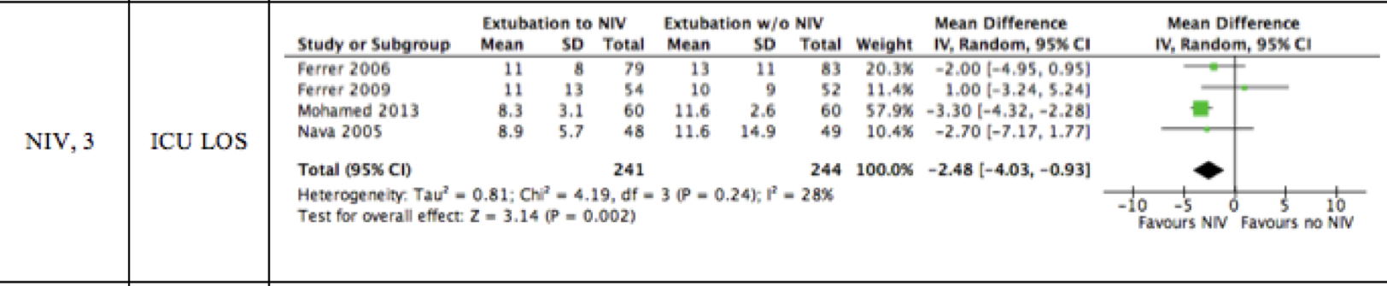
c
Evidence
NIV improves ICU LOS
Ouellette et al, Chest. 2017 Jan;151(1):166-180
Notes:
Four studies examined the outcomes of ICU length of stay and short- term mortality, with the finding that NIV was significantly better than conventional therapy for each outcome (ICU length of stay: mean difference, –2.48 days; 95% CI, –4.03 to –0.93; short-term mortality: RR, 0.37; 95% CI, 0.19-0.70).

Slide 12
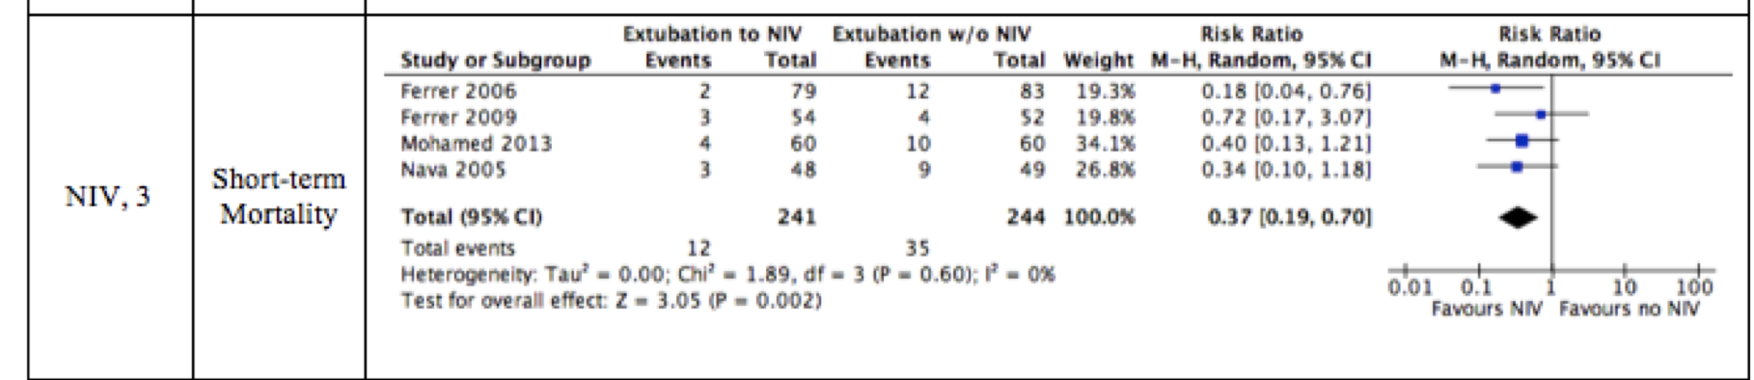
c
Evidence
NIV improves short term mortality
Ouellette et al, Chest. 2017 Jan;151(1):166-180

Slide 13
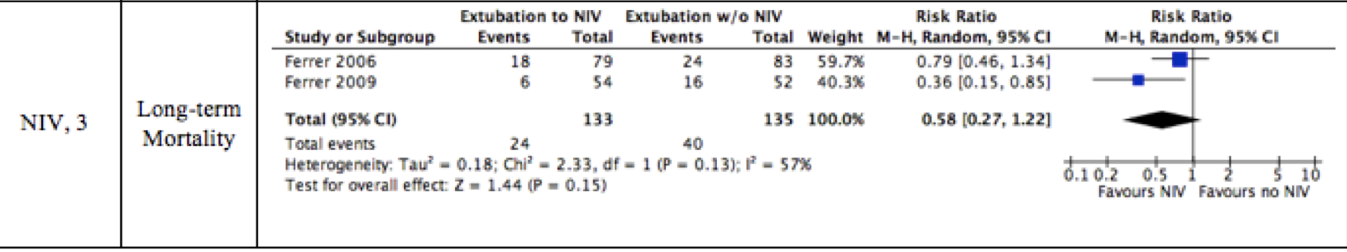
c
Evidence
NIV improves long term mortality
Ouellette et al, Chest. 2017 Jan;151(1):166-180
Notes:
Two studies36,37 demonstrated significantly lower long-term mortality with NIV compared with standard care in high-risk patients following extubation (RR, 0.58; 95% CI, 0.27-1.22). There was heterogeneity between studies in defining the high- risk patient.

Slide 14
DDisc
Case 1
Which of the following is true regarding extubation strategy for this patient?
1. Post-extubation NIV will only reduce rate of reintubation
2. Post-extubation NIV does not change any clinical outcomes
3. Post-extubation NIV will reduce rate of intubation and 60 d mortality
4. Post-extubation NIV is contraindicated in this patient

Slide 15
DDisc
Who qualifies as high risk patient?
Studies are heterogenous:
Nava et al : Failed >1 SBT, PaCO2 > 45 mm Hg after extubation, > 1 comorbid condition, weak cough, or upper airway stridor that did not require immediate reintubation
Ferrer et al (2006): Age > 65 years, cardiac failure as a cause for respiratory failure, an APACHE II score > 12 on the day of extubation
Ferrer et al (2009): Mechanically ventilated patients who had hypercapnia with a PaCO2 > 45 mm Hg during a successful SBT
Khilani et al: Any age, acute COPD exacerbation, type 2 respiratory failure requiring mechanical ventilation >48 hours
Mohamed et al: >18 years of age suffering respiratory failure and mechanically ventilated for 48 h or more and tolerated a weaning trial after recovery of their disease that caused respiratory failure

Slide 16

c
Who qualifies as high risk patient?

Slide 17
D
Who qualifies as high risk patient?
Think of ……..
Age >65
COPD
Chronic hypercapnia (PaCO2 >45 mmHg)
CHF
Failed SBTs
Significant comorbidities
Severity of illness

Slide 18
D
Case 2
Does our patient qualify as high risk?
67 y/o male with COPD, CHF with EF 35%, HTN, HLD who is admitted to ICU and mechanically ventilated > 3 days for acute respiratory failure secondary to community acquired pneumonia.
YES

Slide 19
D
Case 3
Does this patient qualify as high risk?
40 y/o female with HTN intubated for angioedema secondary to lisinopril. 36 hours post intubation, she is awake and alert, passes SBT, +ve cuff leak test. ABG is within normal range. Would she benefit from extubation to NIV?
NO

Slide 20
D
Case 4
Does this patient qualify as high risk?
82 y/o male with BPH, HTN, and HLD admitted with influenza A pneumonia requiring intubation for 3 days. Now on minimal vent settings, passes SBT.
ABG → pH 7.37 PaCO2 40 PaO2 98 HCO3 24.
Would he benefit from extubation to NIV?
NO

Slide 21
D
Case 5
70 y/o male with COPD on 2 L O2 at home, CHF, HTN, and HLD.
Intubated due to acute hypercapnic respiratory failure secondary to acute COPD exacerbation. After 2 days, he is no longer wheezing. ABG is normalized. Passes SBT trial and is subsequently extubated. Ten hours later patient has worsening respiratory distress with worsening hypercapnia.

Slide 22
D
Case 5
Which of the following is true?
Application of NIV will improve mortality
Application of NIV is associated with increased mortality
Application of NIV will reduce rate of reintubation compared to supplemental O2 therapy
Application of NIV will decrease ICU LOS

Slide 23
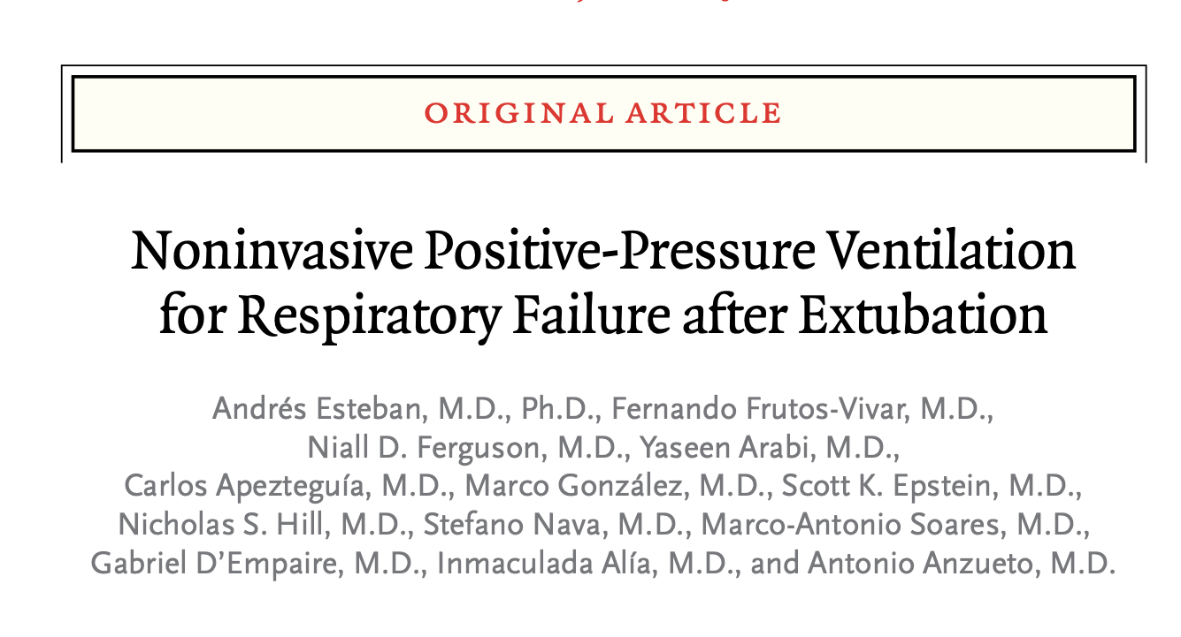
D
Evidence
Esteban et al. New England Journal of Medicine. 2004 Jun 10;350(24):2452-60

Slide 24
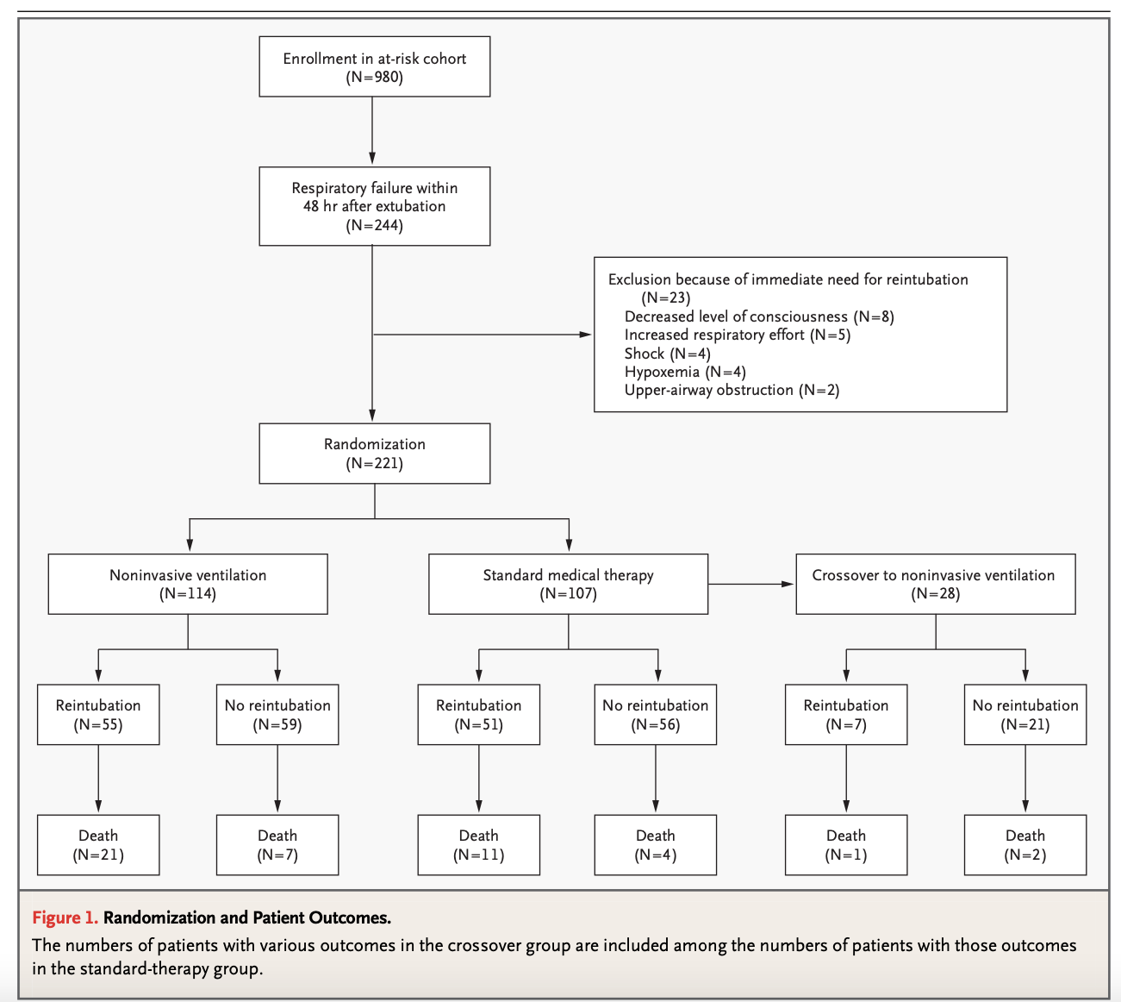
D
Evidence
Respiratory Failure: 2 out of 3
Resp Acidosis (defined as an arterial pH < 7.35 with pCO2 >45 mmHg)
clinical signs of respiratory muscle fatigue or increased respiratory effort
RR > 25 for two consecutive hours
O2 sat <90% or PaO2 <80 mmHg with FiO2 >0.5
Avg time to respiratory failure = 9 hours
Reintubation was considered if at least 1 hour of NIV or standard therapy and 1 of the following:
Lack of improvement in the pH or PaCo2
Change in mental status → cannot use NIV
O2 sat < 85% despite high FiO2
Lack of improvement in signs of respiratory-muscle fatigue
Hypotension
Copious secretions that could not be adequately cleared or that were associated with acidosis, hypoxemia, or changes in mental status.
Esteban et al. New England Journal of Medicine. 2004 Jun 10;350(24):2452-60
Notes:
NIV – Use of NIV for 4 hours at time. Could take 15-20 min breaks for water or nursing care
Standard therapy: Supplemental O2, chest PT, bronchodilator

Slide 25
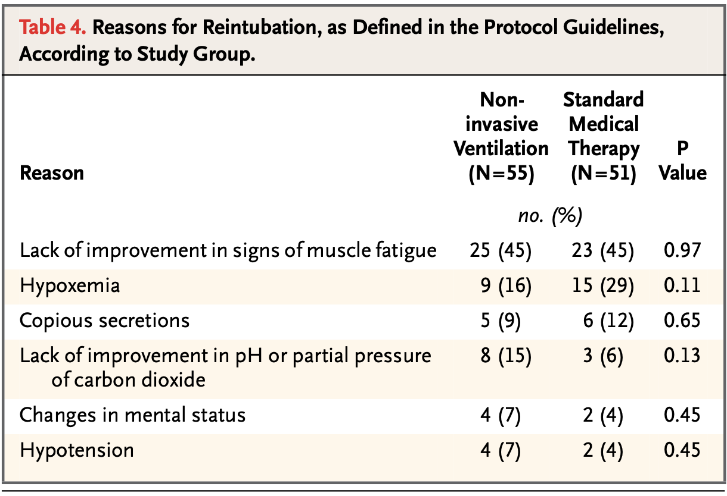
D
Evidence
Primary Outcome - Mortality
28/114 pts in NIV (25%, 95% CI 17-34)
Vs
15/107 in standard medical therapy
(14%; 95% CI 8-23)
P=0.048
Worse mortality in NIV group
No difference in rate of reintubation
No difference in ICU LOS
Esteban et al. New England Journal of Medicine. 2004 Jun 10;350(24):2452-60
Notes:
the interval between the development of respiratory failure and reintubation was significantly longer in the noninvasive-ventilation group (median, 12 hours; interquartile range, 2 hours 10 minutes to 28 hours) than in the standard-therapy group (median, 2 hours 30 minutes; interquartile range, 45 minutes to 16 hours 30 minutes; P=0.02

Slide 26
D
Case 5
Which of the following is true?
Application of NIV will improve mortality
Application of NIV is associated with increased mortality
Application of NIV will reduce rate of reintubation compared to supplemental O2 therapy
Application of NIV will decrease ICU LOS

Slide 27
D
Case 7
42 y/o male with BMI 27 and PMH of seizures who was intubated for airway protection in the setting of seizures and AMS. Patient was loaded with antiepileptics and 24 hours later, patient was awake on the vent and following commands. Vitals were stable. Labs showed mild hyponatremia to 130 but otherwise unremarkable. APACHE II score is 5.
Passes SBT.

Slide 28
D
Case 6
Which of the following is true?
1. Extubation to HFNC will reduce rate of reintubation as compared to standard O2 therapy.
2. Extubation to HFNC will reduce time to reintubation
3. Extubation to HFNC will not reduce rate of intubation as compared to standard O2 therapy
4. Extubation to HFNC will reduce rate of intubation but does not reduce time to reintubation.

Slide 29
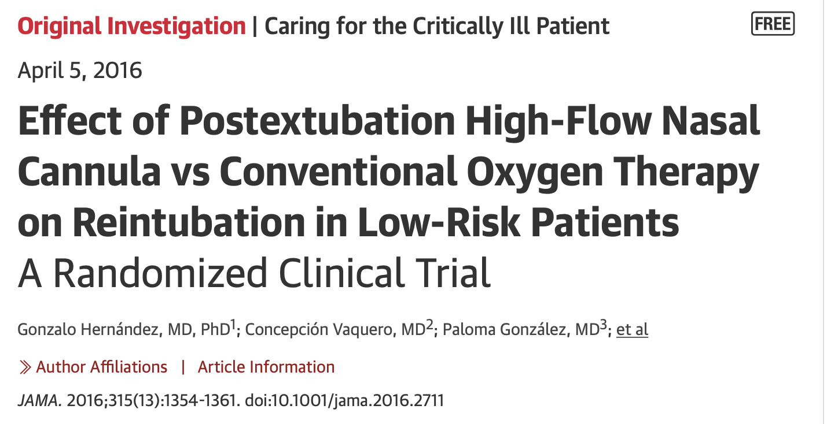
D
Evidence
Hernández et al. JAMA.2016;315(13):1354–1361. doi:10.1001/jama.2016.2711

Slide 30
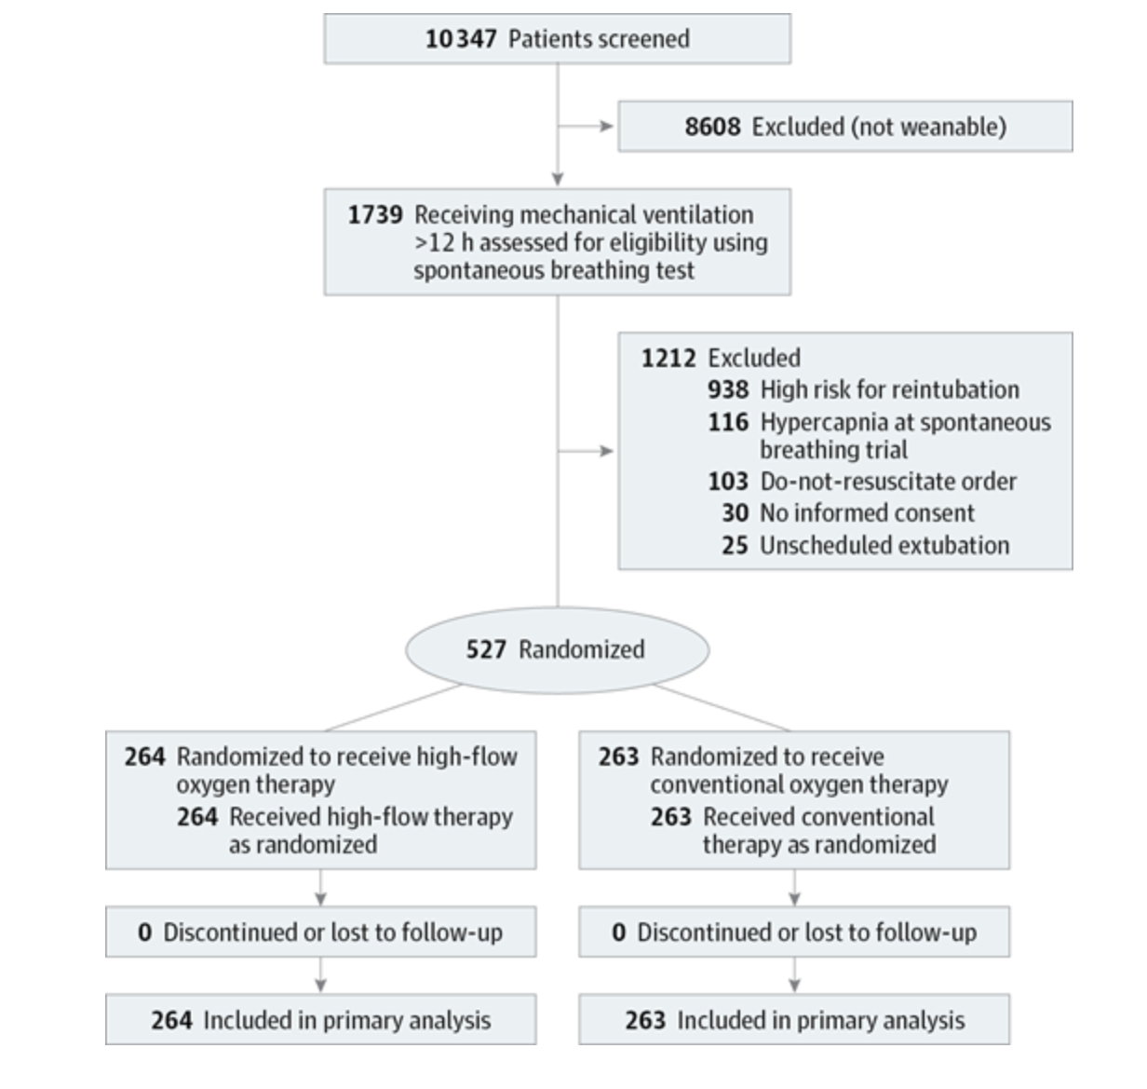
D
Evidence
Low Risk of Intubation: All of the following
< 65 years
APACHE II < 12 on day of extubation
BMI < 30
Adequate secretions management
Simple weaning
0 or 1 comorbidity
No CHF, COPD, airway obstruction, prolonged MV
Hernández et al. JAMA.2016;315(13):1354–1361. doi:10.1001/jama.2016.2711
Notes:
HF vs NC for 24 hours

Slide 31
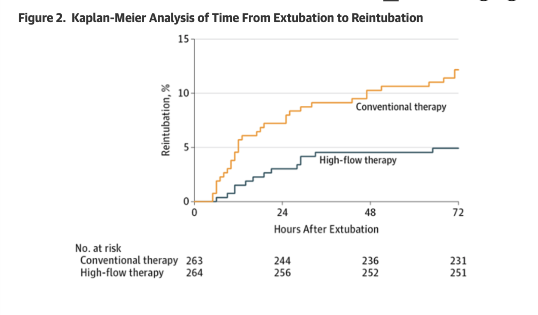
D
Evidence
p =0.04
Hernández et al. JAMA.2016;315(13):1354–1361. doi:10.1001/jama.2016.2711
Notes:
HF vs NC for 24 hours

Slide 32
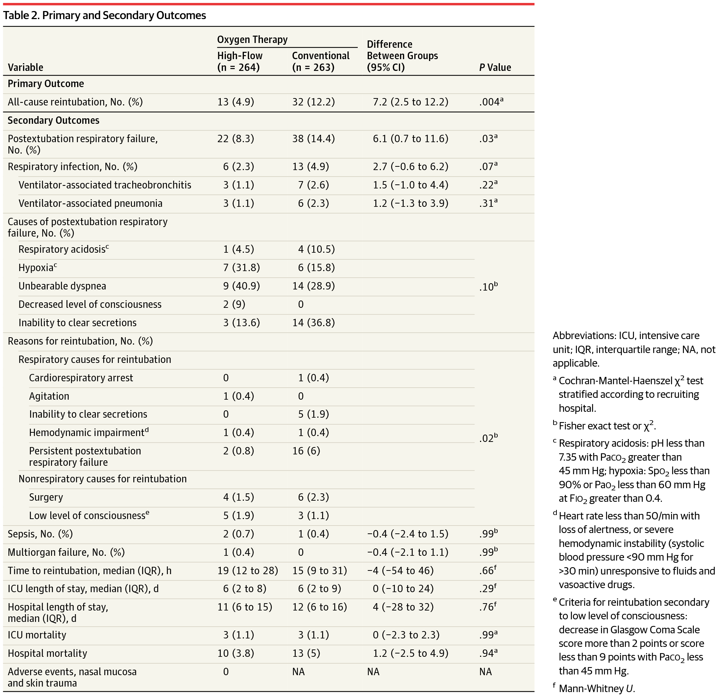
D
Evidence
Hernández et al. JAMA.2016;315(13):1354–1361. doi:10.1001/jama.2016.2711
Notes:
HF vs NC for 24 hours

Slide 33
D
Case 6
Which of the following is true?
1. Extubation to HFNC will reduce rate of reintubation as compared to standard O2 therapy.
2. Extubation to HFNC will reduce time to reintubation
3. Extubation to HFNC will not reduce rate of intubation as compared to standard O2 therapy
4. Extubation to HFNC will reduce rate of intubation but does not reduce time to reintubation.

Slide 34
D
Case 7
72 y/o female with COPD, HTN, CHF with EF 40% intubated for acute hypoxic respiratory failure secondary to CHF exacerbation. On Day 3 patient passes SBT.
Which of the following would you choose as an extubation strategy?
Extubation to NIV + HFNC
Extubation to NIV alone
Extubation to HFNC
Extubation to 6L NC

Slide 35
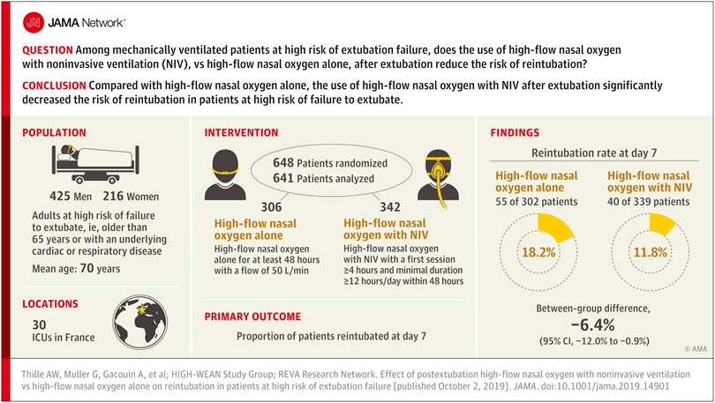
D
Evidence
P=0.02
Thille et al. JAMA. 2019;322(15):1465–1475. doi:10.1001/jama.2019.14901
Notes:
HF vs NC for 24 hours

Slide 36
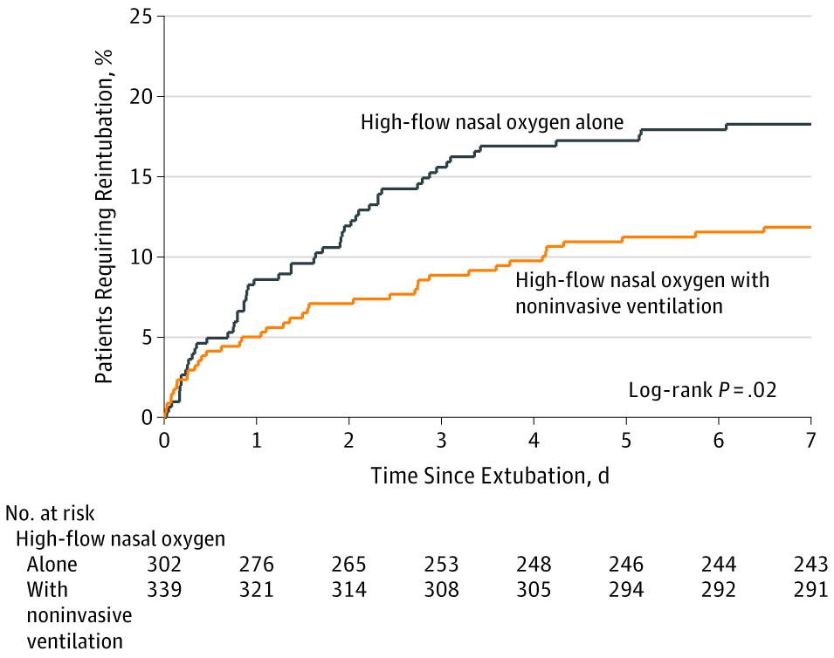
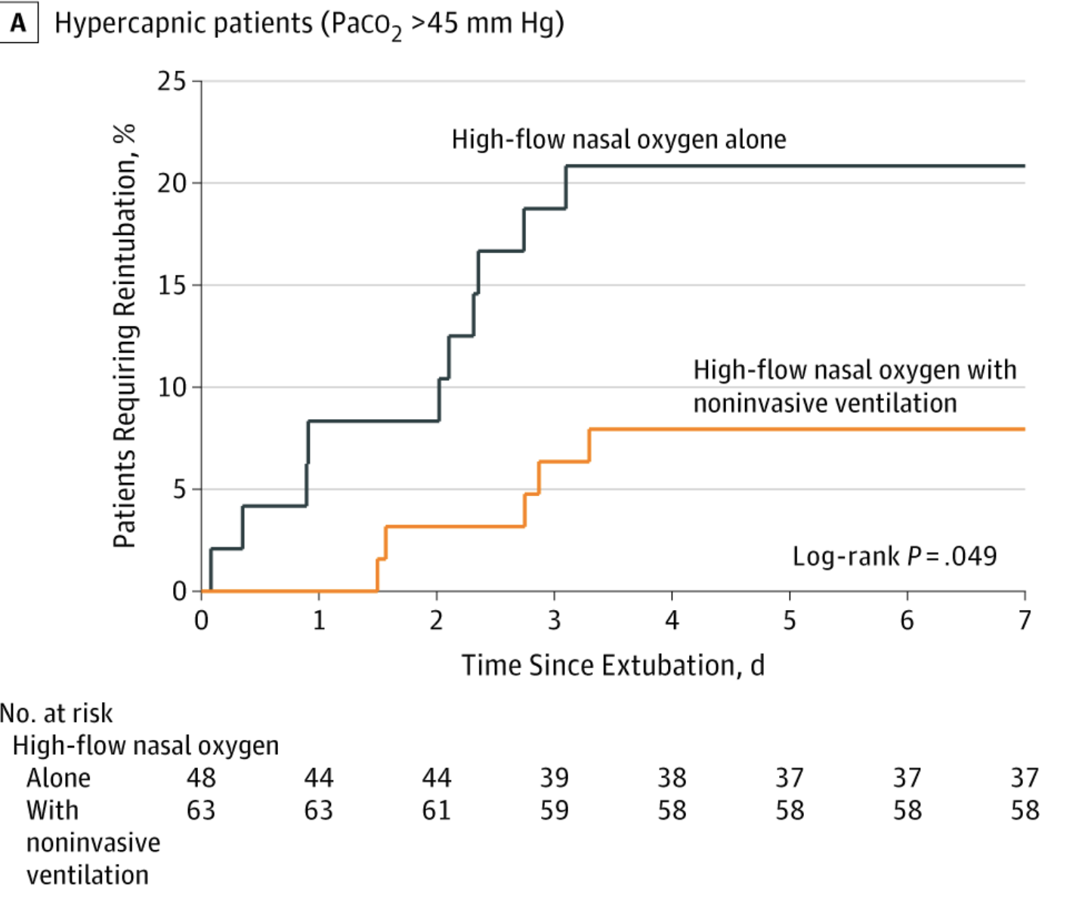
D
Evidence
Thille et al. JAMA. 2019;322(15):1465–1475. doi:10.1001/jama.2019.14901

Slide 37
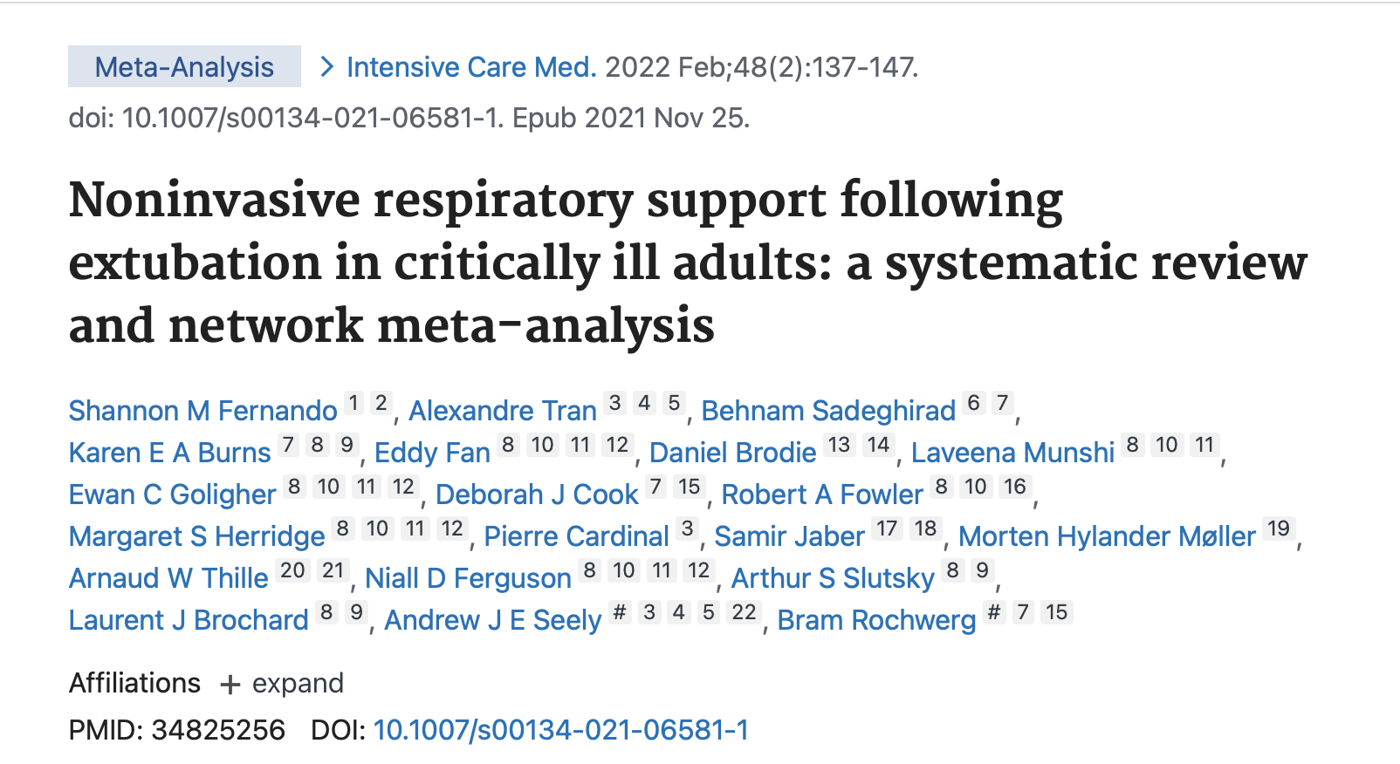
D
Evidence
Fernando et. Intensive Care Med. 2022 Feb;48(2):137-147. doi: 10.1007/s00134-021-06581-1. Epub 2021 Nov 25. PMID: 34825256.

Slide 38
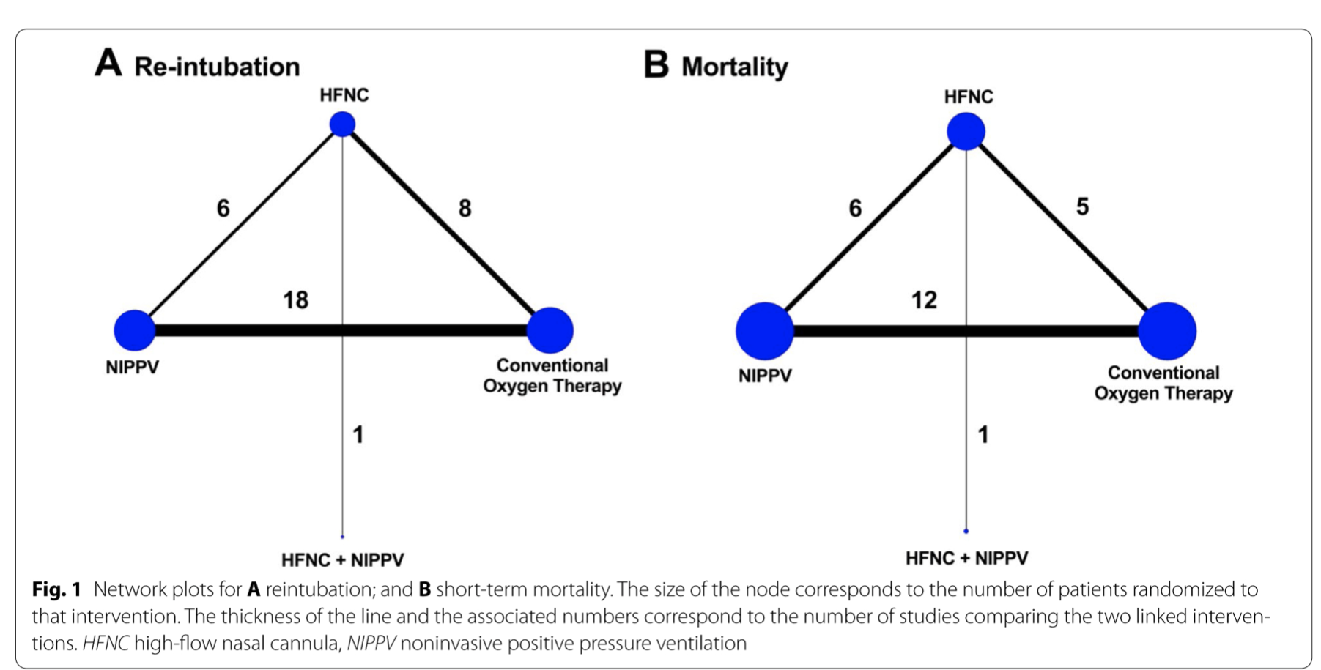
D
Evidence
Fernando et. Intensive Care Med. 2022 Feb;48(2):137-147. doi: 10.1007/s00134-021-06581-1. Epub 2021 Nov 25. PMID: 34825256.

Slide 39
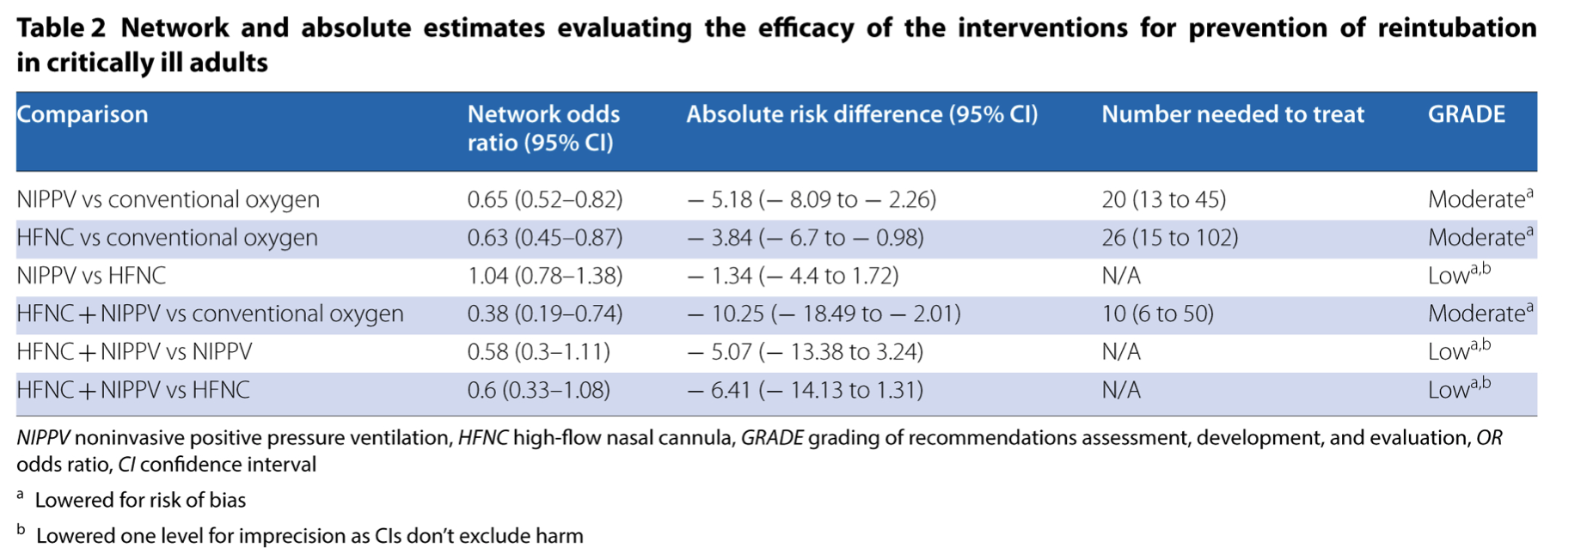
D
Evidence
Fernando et. Intensive Care Med. 2022 Feb;48(2):137-147. doi: 10.1007/s00134-021-06581-1. Epub 2021 Nov 25. PMID: 34825256.

Slide 40
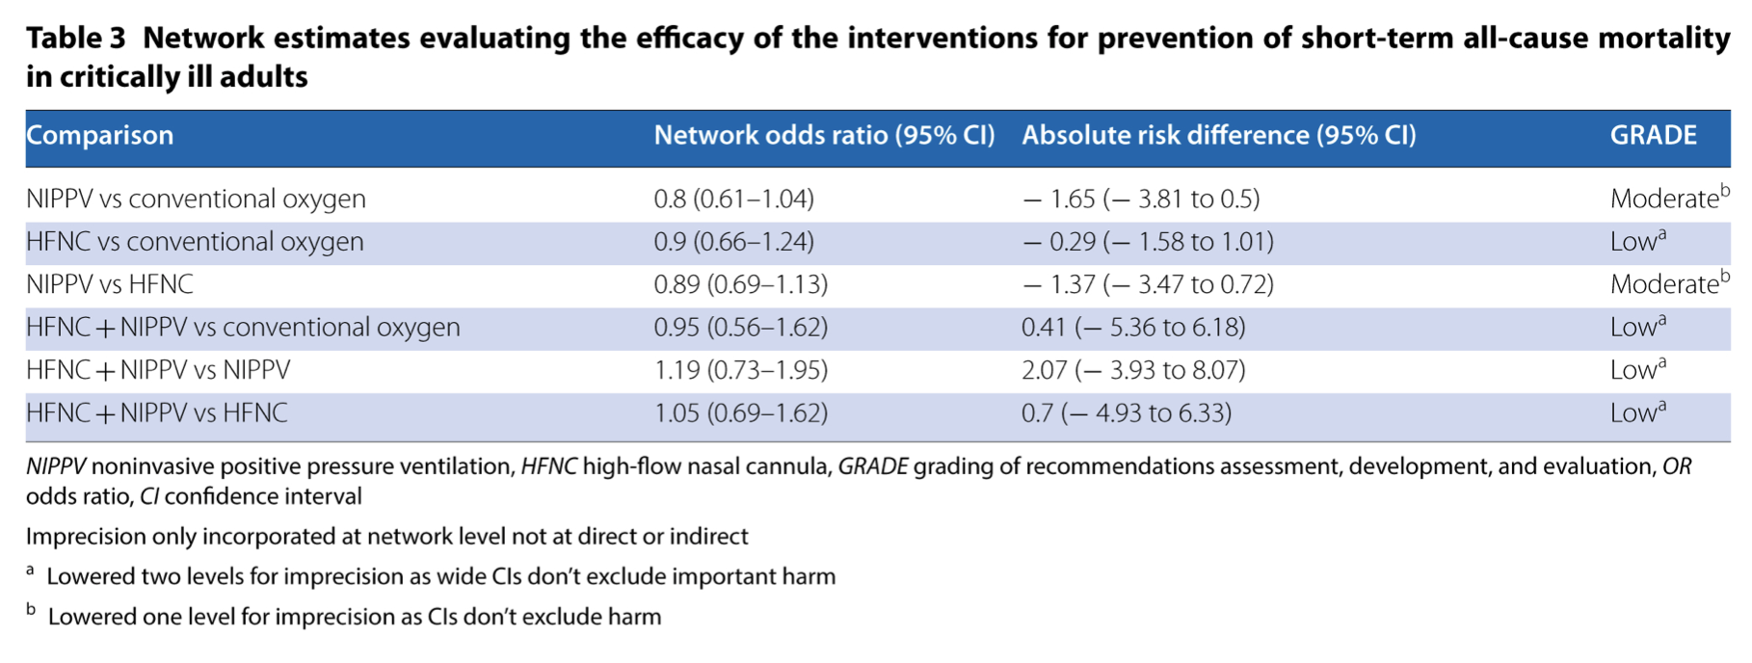
D
Evidence
Fernando et. Intensive Care Med. 2022 Feb;48(2):137-147. doi: 10.1007/s00134-021-06581-1. Epub 2021 Nov 25. PMID: 34825256.
Notes:
28 d, 30 d or in hospital mortality

Slide 41
Key Points
HFNC vs NIV → equally efficacious in post extubation period to prevent reintubation compared to conventional oxygen therapy
Use NIV prophylactically post extubation as compared to at the time of extubation failure as it is associated with increased mortality
Use NIV + HFNC versus HFNC to prevent reintubation in high risk patients
Always take into account the accessible resources you have as some of the above interventions may be limited based on the availability of resources

Slide 42
References
Ouellette DR, Patel S, Girard TD, Morris PE, Schmidt GA, Truwit JD, Alhazzani W, Burns SM, Epstein SK, Esteban A, Fan E, Ferrer M, Fraser GL, Gong MN, Hough CL, Mehta S, Nanchal R, Pawlik AJ, Schweickert WD, Sessler CN, Strøm T, Kress JP. Liberation From Mechanical Ventilation in Critically Ill Adults: An Official American College of Chest Physicians/American Thoracic Society Clinical Practice Guideline: Inspiratory Pressure Augmentation During Spontaneous Breathing Trials, Protocols Minimizing Sedation, and Noninvasive Ventilation Immediately After Extubation. Chest. 2017 Jan;151(1):166-180. doi: 10.1016/j.chest.2016.10.036. Epub 2016 Nov 3. PMID: 27818331.
Ferrer M, Valencia M, Nicolas JM, Bernadich O, Badia JR, Torres A. Early noninvasive ventilation averts extubation failure in patients at risk: a randomized trial. Am J Respir Crit Care Med. 2006;173(2): 164-170.
Ferrer M, Sellares J, Valencia M, et al. Non-invasive ventilation after extubation in hypercapnic patients with chronic respiratory disorders: randomised controlled trial. Lancet. 2009;374(9695): 1082-1088.
Khilnani GC, Galle AD, Hadda V, Sharma SK. Non-invasive ventilation after extubation in patients with chronic obstructive pulmonary disease: a randomized controlled trial. Anaesth Intensive Care. 2011;39:217-223.
Mohamed KAE, Abdalla MH. Role of noninvasive ventilation in limiting reintubation after planned extubation. Egypt J Chest Dis Tuberc. 2013;62(4):669-674.
Esteban A, Frutos-Vivar F, Ferguson ND, Arabi Y, Apezteguía C, González M, Epstein SK, Hill NS, Nava S, Soares MA, D'Empaire G. Noninvasive positive-pressure ventilation for respiratory failure after extubation. New England Journal of Medicine. 2004 Jun 10;350(24):2452-60.
Hernández G, Vaquero C, González P, et al. Effect of Postextubation High-Flow Nasal Cannula vs Conventional Oxygen Therapy on Reintubation in Low-Risk Patients: A Randomized Clinical Trial. JAMA.2016;315(13):1354–1361. doi:10.1001/jama.2016.2711
Thille AW, Muller G, Gacouin A, et al. Effect of Postextubation High-Flow Nasal Oxygen With Noninvasive Ventilation vs High-Flow Nasal Oxygen Alone on Reintubation Among Patients at High Risk of Extubation Failure: A Randomized Clinical Trial. JAMA. 2019;322(15):1465–1475. doi:10.1001/jama.2019.14901
Fernando SM, Tran A, Sadeghirad B, Burns KEA, Fan E, Brodie D, Munshi L, Goligher EC, Cook DJ, Fowler RA, Herridge MS, Cardinal P, Jaber S, Møller MH, Thille AW, Ferguson ND, Slutsky AS, Brochard LJ, Seely AJE, Rochwerg B. Noninvasive respiratory support following extubation in critically ill adults: a systematic review and network meta-analysis. Intensive Care Med. 2022 Feb;48(2):137-147. doi: 10.1007/s00134-021-06581-1. Epub 2021 Nov 25. PMID: 34825256.

Slide 43

Questions

